Slide 1
Faculty of Mechanical Engineering - Institute of Solid Mechanics
Chair of computational and Experimental Solid Mechanics
Master Thesis
Analysis of the Failure Behavior of Carbon Fibre Reinforced Polymer Open Hole Tensile Test Specimens
Submitted/Presented by: | Apurv Kulkarni
Matriculation Number: | 4815274
Degree Program: | Computational Modelling and Simulation
Field of Study: | Computational Engineering
Date of Submission: | 4 May 2021
Place and Date: | Dresden, 26 May 2021

Slide 2
Contents
Motivation
Basics
Material model
Design of experiments and Sensitivity analysis
Numerical Experiments
Framework
Results
Conclusion

Slide 3
1. Motivation
Notes:
3

Slide 4
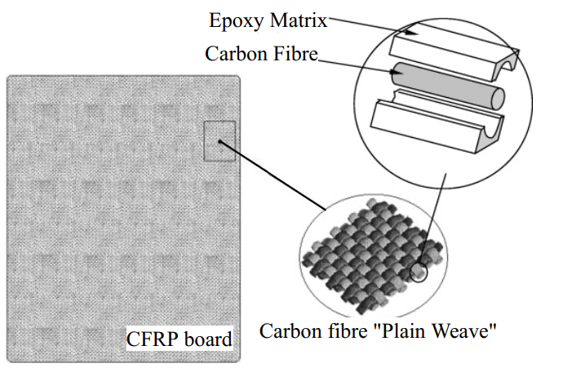
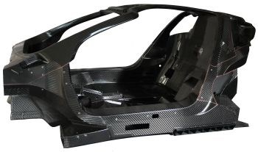
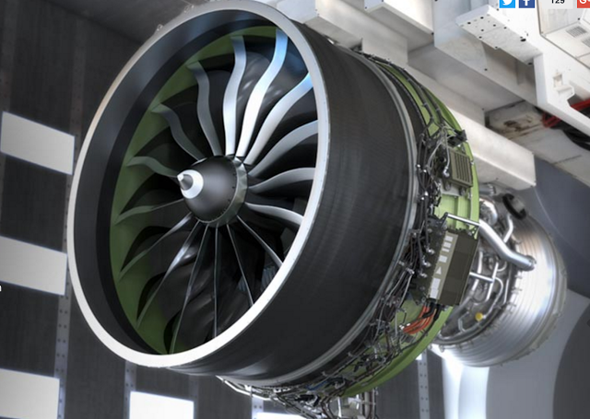

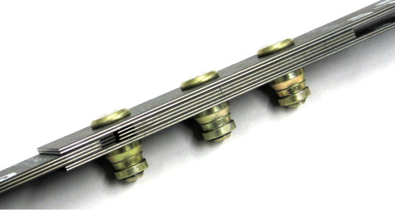
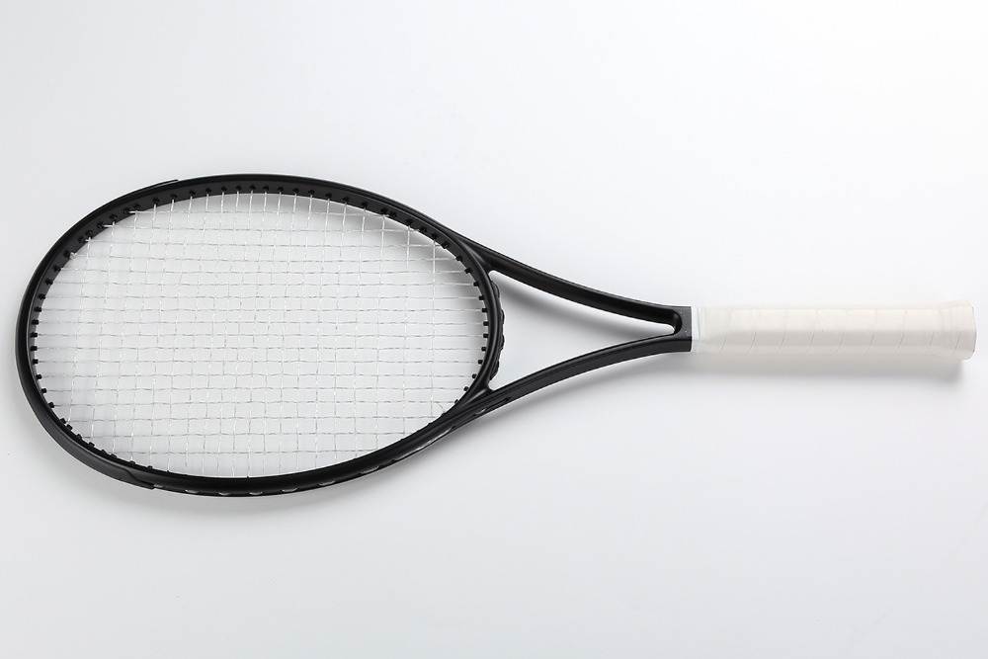
1. Motivation
Carbon Fibre Reinforced Polymer Composites (CFRP)
Heterogeneous systems
Reinforcement ► Carbon Fibre
High specific strength
Matrix ► Epoxy resin
Binding fibres and load transmission
Properties
High strength
High stiffness
Low weight
Applications
Reinforcement material
[1]
Carbon Fibre
CFRP board
Carbon Fibre “Plain Weave”
[2]
[3]
[4]
Mechanical Joints
[5]
[6]

Slide 5
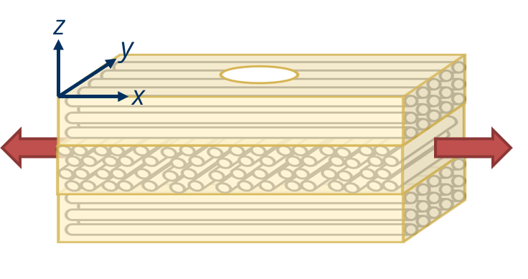
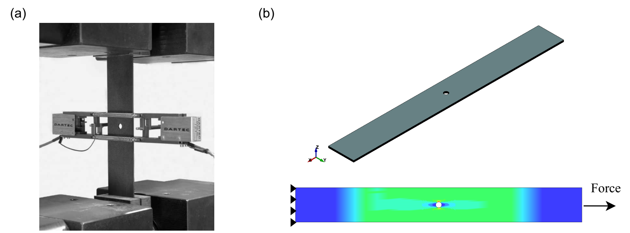
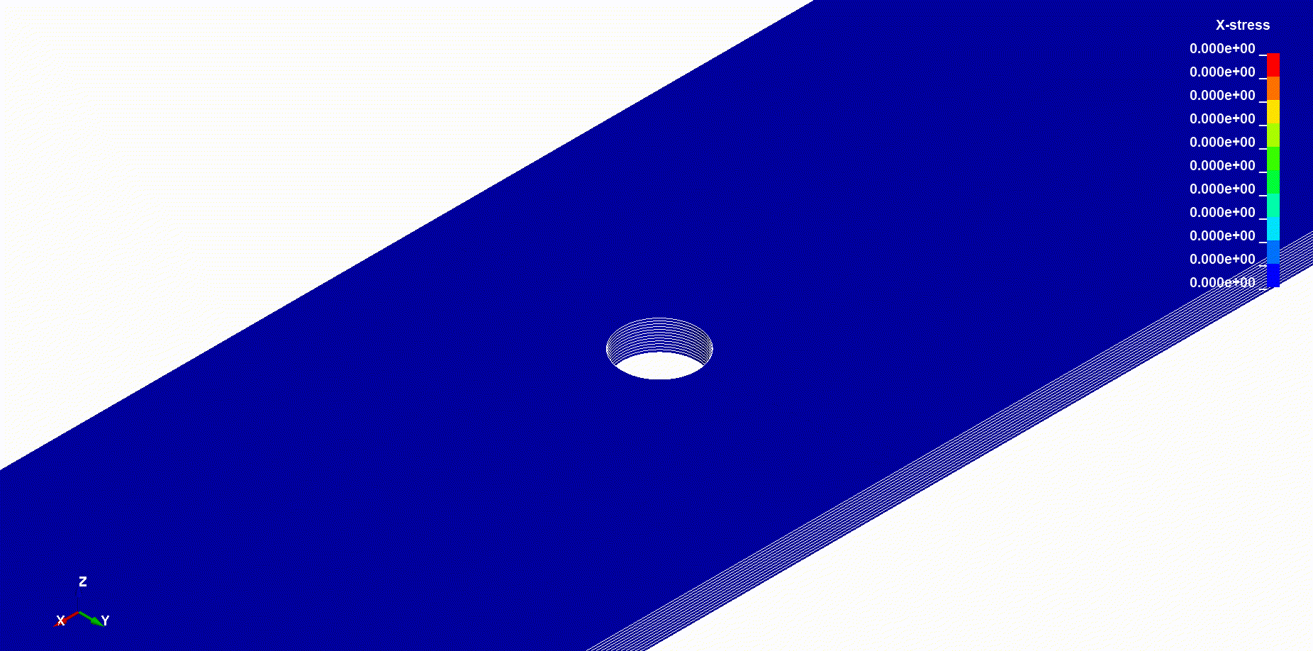

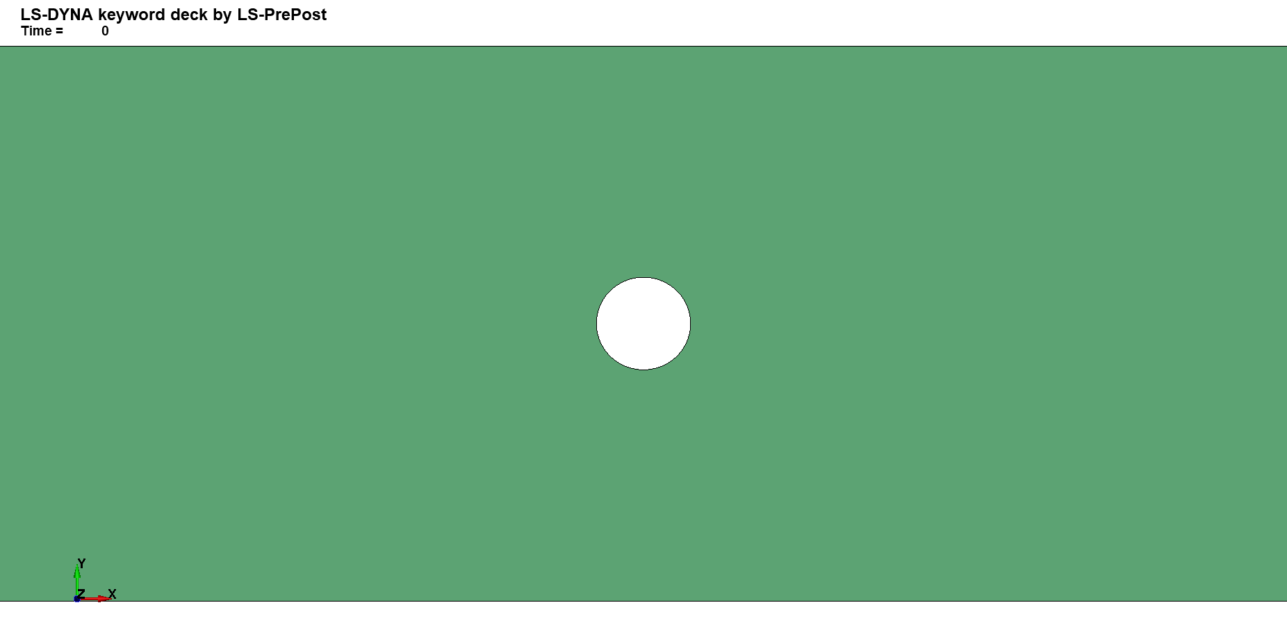

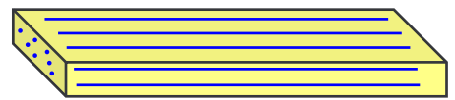
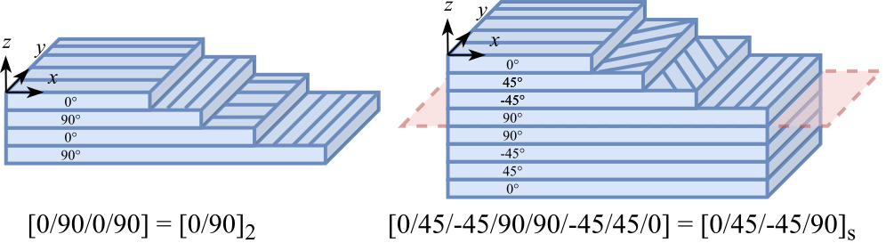
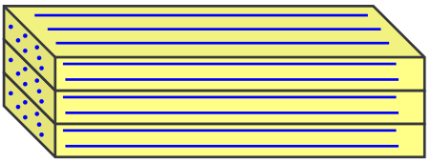
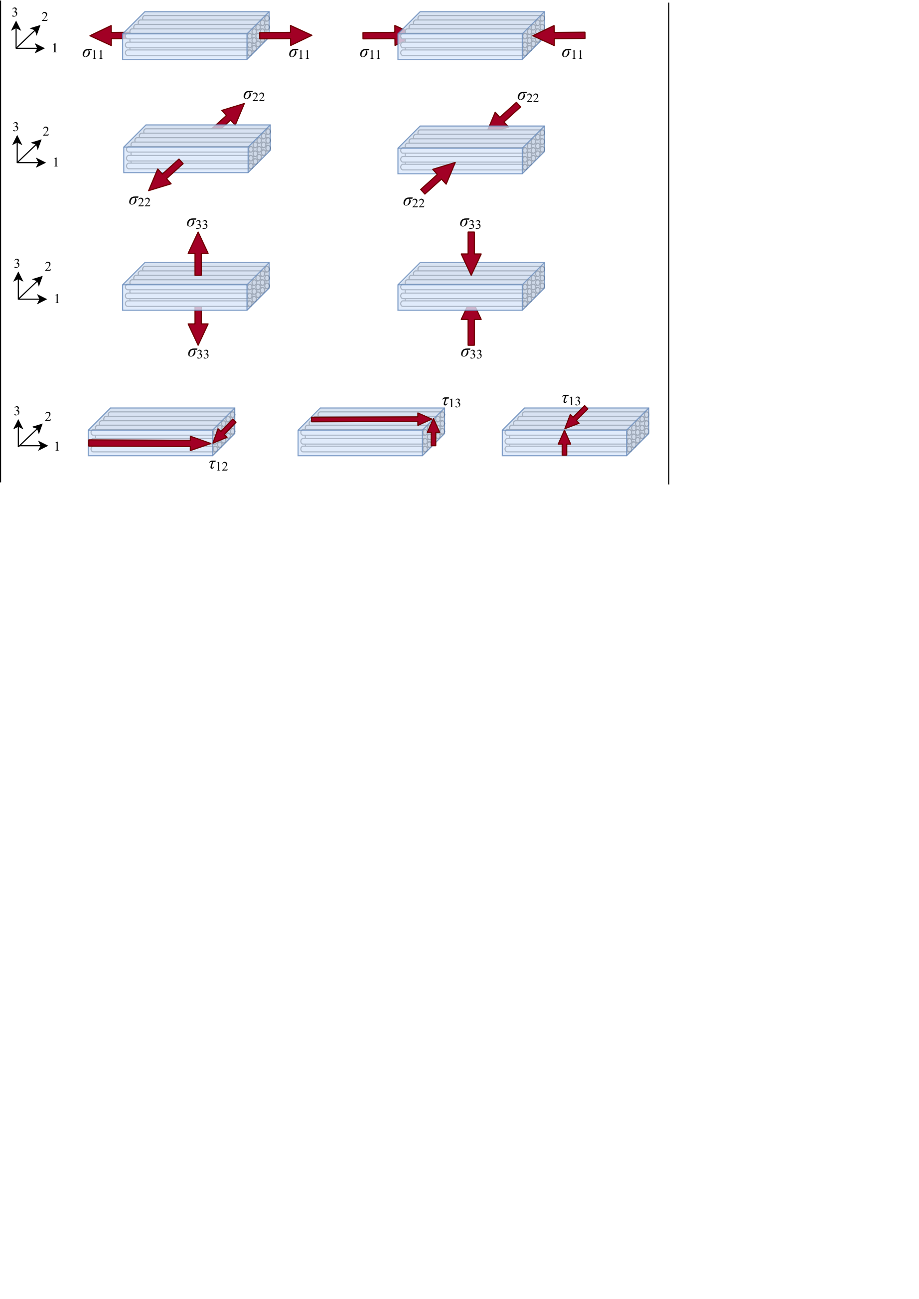

1. Motivation
Open hole tensile (OHT) testing
Failure in CFRP
Material composition – volume fraction, component properties
Geometry
Orientation/Layup
Loading conditions
[7]
Orthotropic materials*
2
x
1
y

Slide 6
1. Motivation
Objective:
Perform analysis to understand the influence of material parameters
and notch geometry on an open hole specimen under tensile loading.

Slide 7
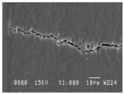
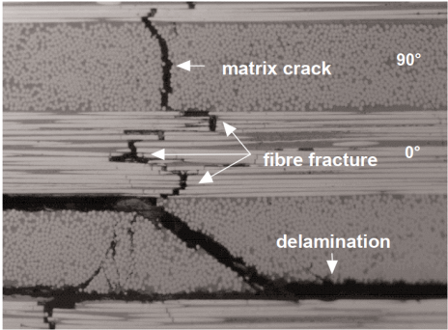
1. Motivation
Objective:
Perform analysis to understand the influence of material parameters
and notch geometry on an open hole specimen under tensile loading.
Scope:
Understanding failure in CFRP structures,
[8]
[9]
Matrix crack
Matrix crack
90º
Fibre fracture
0º
Delamination

Slide 8
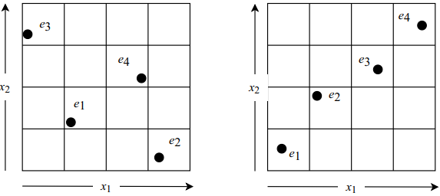
1. Motivation
Objective:
Perform analysis to understand the influence of material parameters
and notch geometry on an open hole specimen under tensile loading.
Scope:
Understanding failure in CFRP structures,
Designing computer experiments,
Experiment | Design Variables
 | X₁ | X₂ | … | … | X_{n}
e₁ | x₁₁ | x₁₂ | … | … | x_{1n}
e₂ | x₂₁ | x₂₂ | … | … | x_{2n}
… | … | … | … | … | …
e_{p} | x_{1p} | x_{2p} | … | … | x_{np}
[8]
[9]

Slide 9
1. Motivation
Objective:
Perform analysis to understand the influence of material parameters
and notch geometry on an open hole specimen under tensile loading.
Scope:
Understanding failure in CFRP structures,
Designing computer experiments,
Creating workflow,
Designing
experiments
Running
experiments
Data extraction
Data
analysis

Slide 10
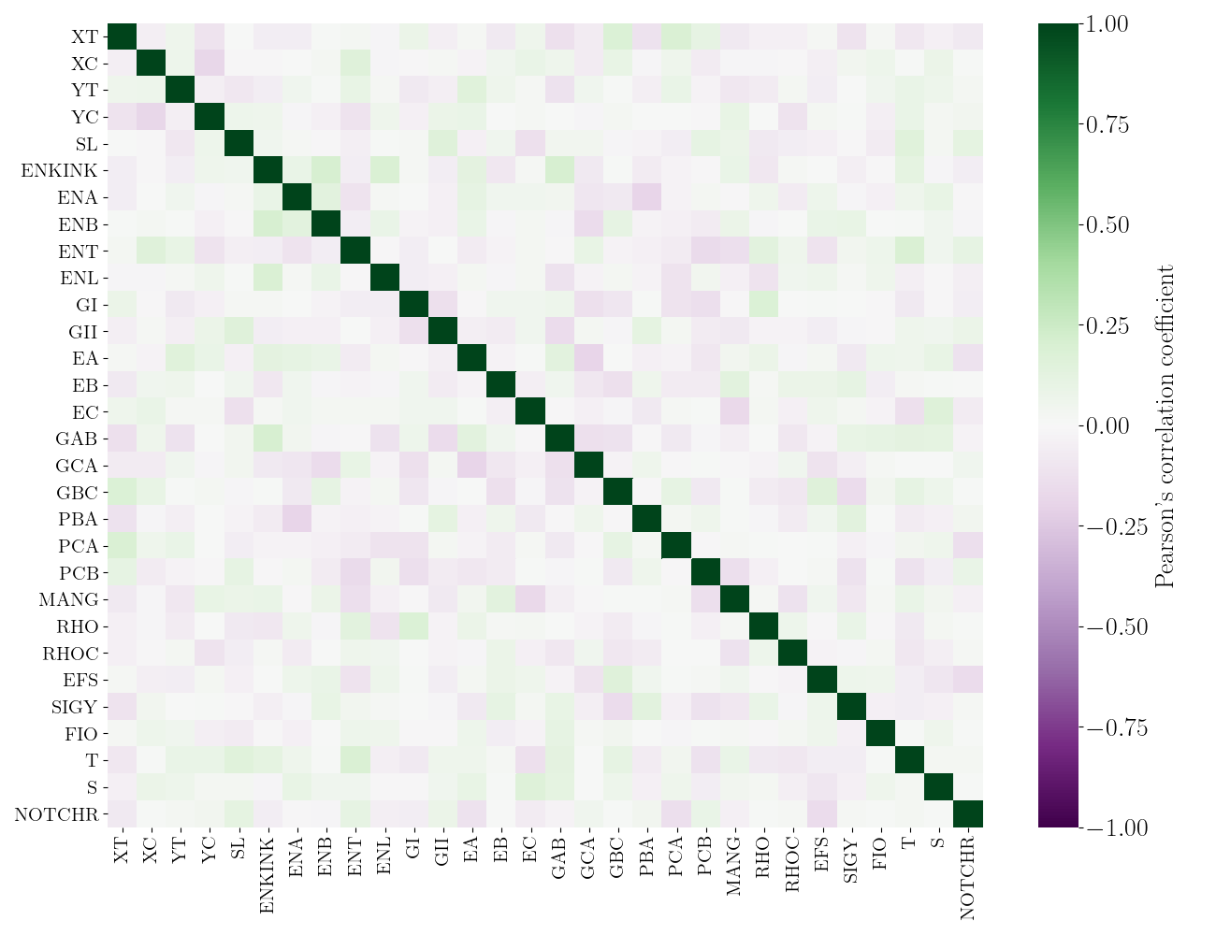


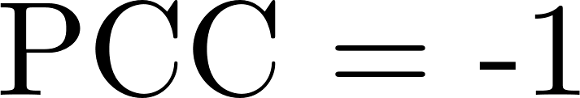
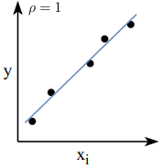
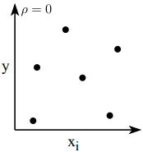
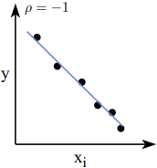


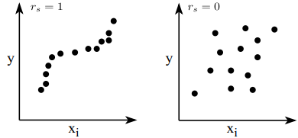
1. Motivation
Objective:
Perform analysis to understand the influence of material parameters
and notch geometry on an open hole specimen under tensile loading.
Scope:
Understanding failure in CFRP structures,
Designing computer experiments,
Creating workflow,
Statistical analysis.

Slide 11
2. Basics
Notes:
11

Slide 12
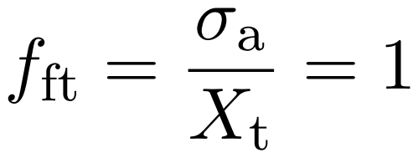
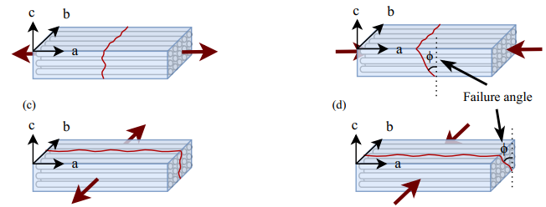
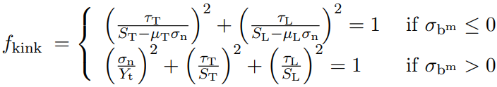
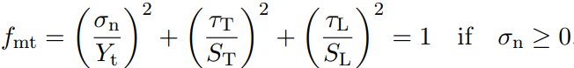
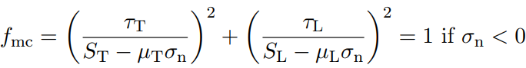
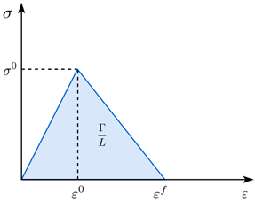
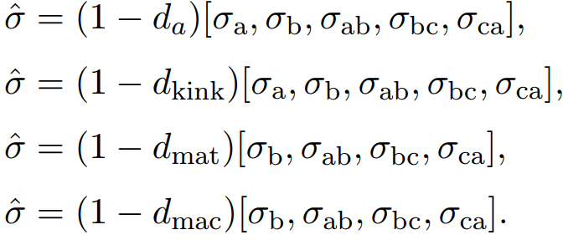
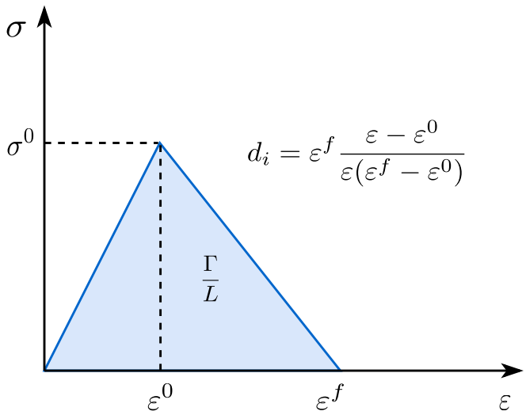
2.3 Material Model
Composite material model proposed by Pinho et al.[16]
Fibre tensile failure:
Fibre compression failure (Kinking):
Matrix tensile failure:
Matrix compressive/shear failure:
Continuum damage model
Fracture angle
Fracture angle
Notes:
Possible question: what is physically based criteria and how It is different from non-physically based criteria

Slide 13
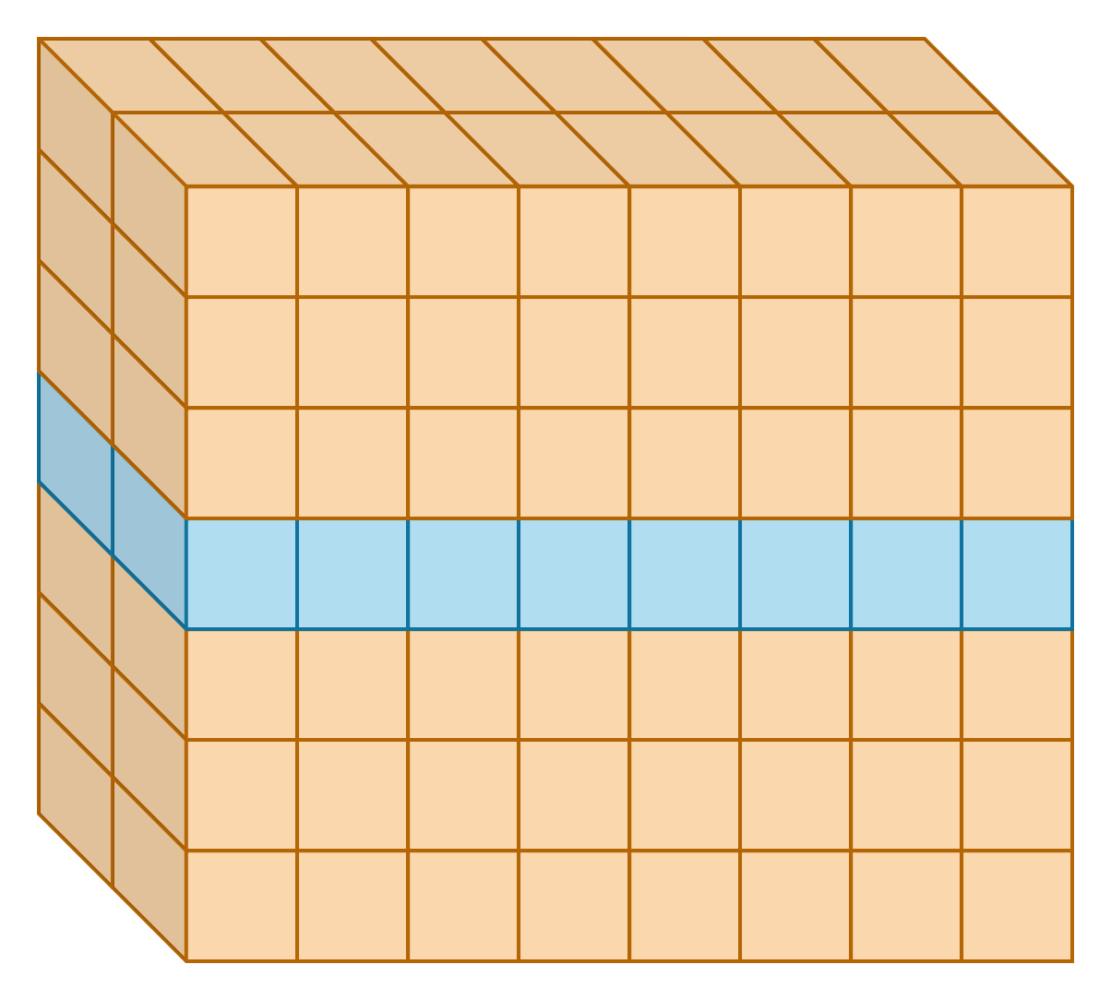
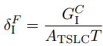
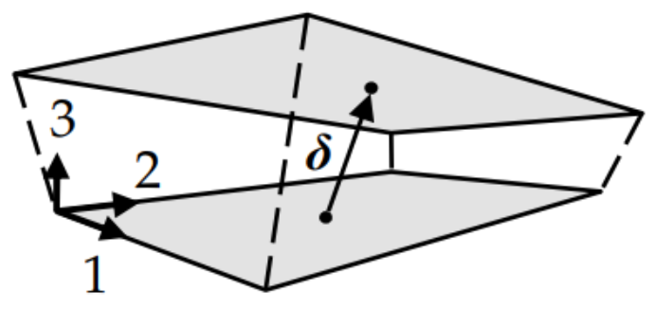
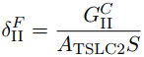
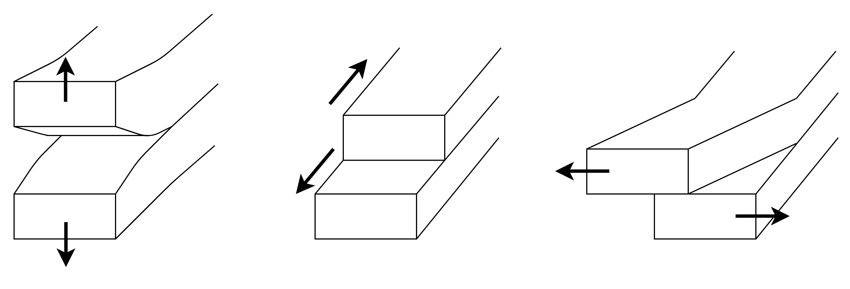
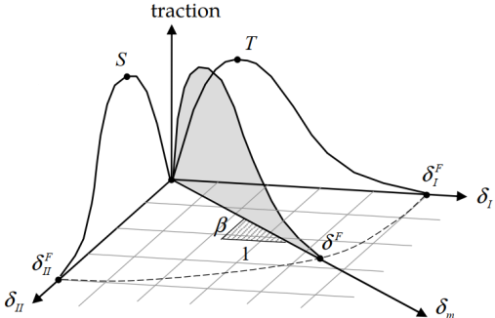
2.3 Material Model
Inter-laminar material modelling proposed by Benzeggagh-Kenane[17]
Zero thickness cohesion elements
Failure criteria – relative displacements, δ
Mode I (Tension):
Mode II (Shear):
Mode III (2nd Shear):
Cohesion element
Traction Separation Law Curve (TSLC)
Mode I
Mode II
Mode III

Slide 14
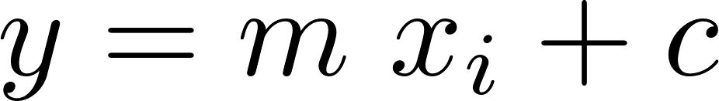
2.4 Design of Experiments and Sensitivity Analysis
Design of experiments
Latin hypercube design (LHD)
No. of experiments independent of no. of design variables
Fewer experiments required
Optimal design
Sensitivity analysis
Linear Regression analysis
Bivariate
Multiple
Pearson’s correlation coefficient (PCC)
PCC = +/- 1 → Strong correlation
PCC = 0 → No correlation
Spearman’s ranked correlation coefficient (SRCC)
SRCC = +/-1 → monotonous relation
SRCC = 0 → no relation
Design
variables
System/Model/Process
Response
variables
Optimal

Slide 15
3. Experiment Framework
Notes:
15

Slide 16
3.1 Workflow
Designing
experiment
Running
experiments
Data extraction
Data analysis

Slide 17

3.1 Workflow
Designing
experiment
Running
experiments
Data extraction
Data analysis
Define
objective
Identifying input variables
Building design matrix using LHD
Creating LS-Dyna
material and geometry cards
[18]

Slide 18
3.1 Workflow
Designing
experiment
Running
experiments
Data extraction
Data analysis
Create sbatch files for submitting jobs on HPC
Run computer experiments using
LS-Dyna analysis software
[18]

Slide 19
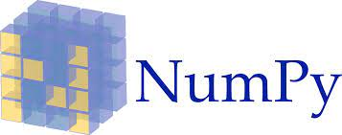

3.1 Workflow
Designing
experiment
Running
experiments
Data extraction
Data analysis
Identifying output variables
Data extraction from results using LS-Prepost macros
Data cleaning
[19]
[18]
[20]

Slide 20



3.1 Workflow
Designing
experiment
Running
experiments
Data extraction
Data analysis
Bivariate Regression analysis
Correlation analysis
Multiple regression analysis
Drawing conclusion
[19]
[20]
[21]
[22]
[23]

Slide 21
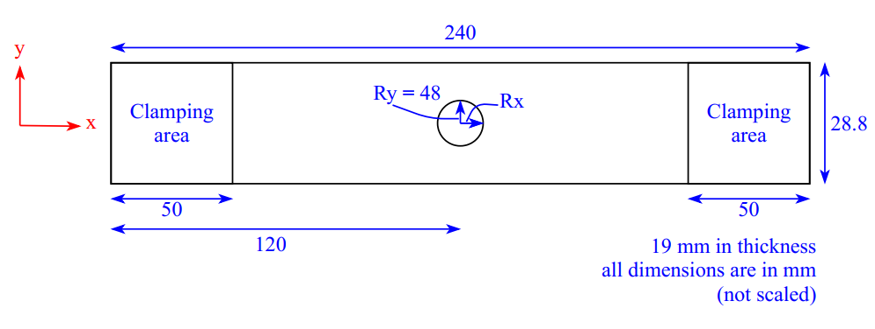
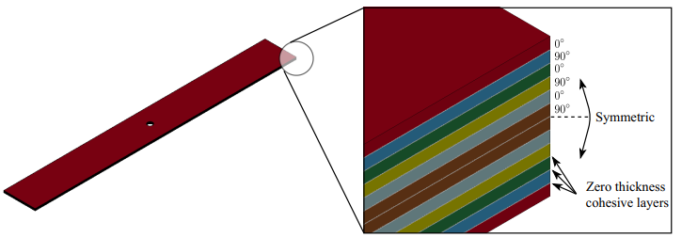
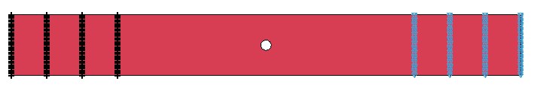
3.2 FEM Model
240
Six layers symmetrically arranged
Configuration – [0/90/0/90/0/90]_{s}
Zero thickness element between each layer
Mesh selection
3 elements in thickness in each layer
Convergence analysis ►140 elements
Boundary conditions on nodes
Clamping
area
Ry = 48
Rx
Clamping area
28.8
50
50
120
19 mm in thickness
All dimensions are in mm
Symmetric
Zero thickness cohesive layers
Fixed nodes
Prescribed motion

Slide 22
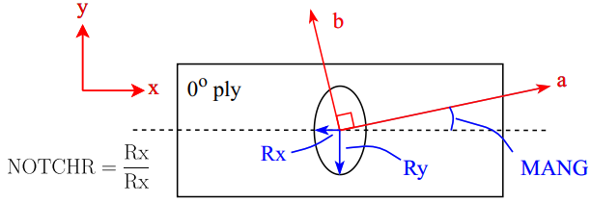
3.3 Experiment Parameters
Design variables (Input parameters)
Strength | XT | Longitudinal tensile strength
 | XC | Longitudinal compressive strength
 | YT | Transverse tensile strength
 | YC | Transverse compressive strength
 | SL | Longitudinal shear strength
Moduli, poisons ratio and Density | EA | Young’s modulus in longitudinal direction
 | EB | Young’s modulus in transverse direction
 | EC | Young’s modulus in through thickness direction
Moduli, poisons ratio and Density | GAB | Shear modulus plane ab
 | GCA | Shear modulus plane ca
 | GBC | Shear modulus plane bc
 | PBA | Poisson’s ratio in ba
 | PCA | Poisson’s ratio in ca
 | PCB | Poisson’s ratio in cb
 | RHO | Mass density of composite material
 | RHOC | Mass density of cohesive layer
Fracture toughness | ENKINK | Fracture toughness for longitudinal (fibre) compressive failure mode
 | ENA | Fracture toughness for longitudinal (fibre) tensile failure mode
 | ENB | Fracture toughness for intralaminar matrix tensile failure
 | ENT | Fracture toughness for intralaminar matrix transverse shear failure
 | ENL | Fracture toughness for intralaminar longitudinal shear failure
 | GI | Fracture toughness mode I
 | GII | Fracture toughness mode II
Other | EFS | Maximum effective strain for element layer failure
 | SIGY | In-plane shear yield stress
 | FIO | Fracture angle in pure transverse compression
 | T | Peak traction in normal direction mode
 | S | Peak traction in tangential direction mode
Geometry | MANG | Misalignment angle of material orientation
 | NOTCHR | Notch radius ratio Rx/Ry with Ry=48mm
Rx
where, Ry = 48mm
Rx
NOTCHR =
Ry
Ry
MANG

Slide 23
3.3 Experiment Parameters
Correlation between design variables – minimum correlation

Slide 24
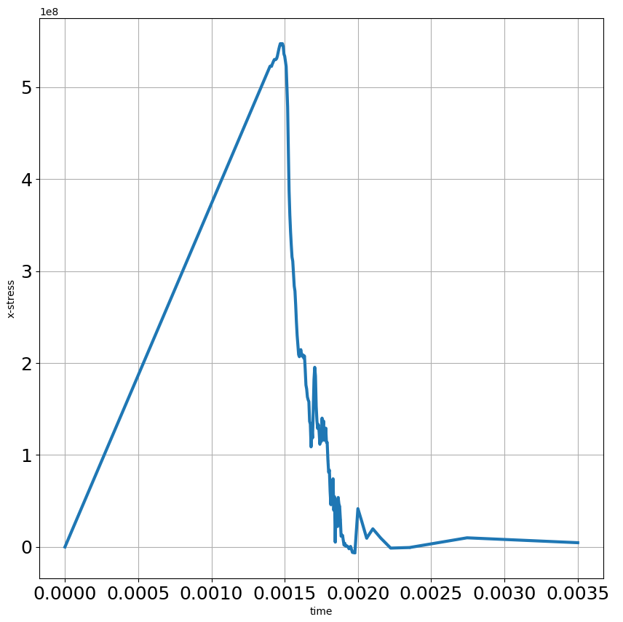
3.3 Experiment Parameters
Response variables (Output parameters)
gMAS | Maximum applied stress in x-direction before failure
gMLS | Maximum longitudinal stress globally at maximum gMAS
gMTS | Maximum transverse stress globally at maximum gMAS
gMPS | Maximum principle stress globally at maximum gMAS
gMSS | Maximum shear stress globally at maximum gMAS
gMIPSS | Maximum in-plane shear stress globally at maximum gMAS
SC | Stress concentration factor at the notch at maximum gMAS
1e8
Maximum applied
stress (gMAS)
Applied stress (MPa)
Time (sec)

Slide 25
4. Results
Notes:
25

Slide 26
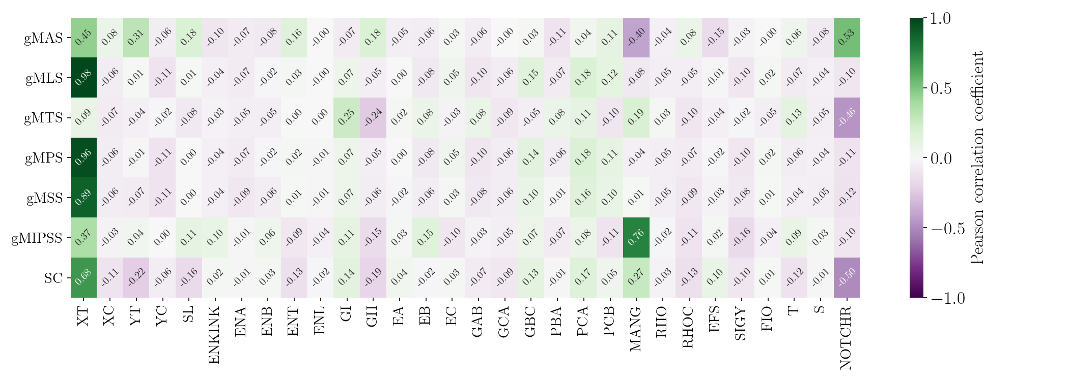
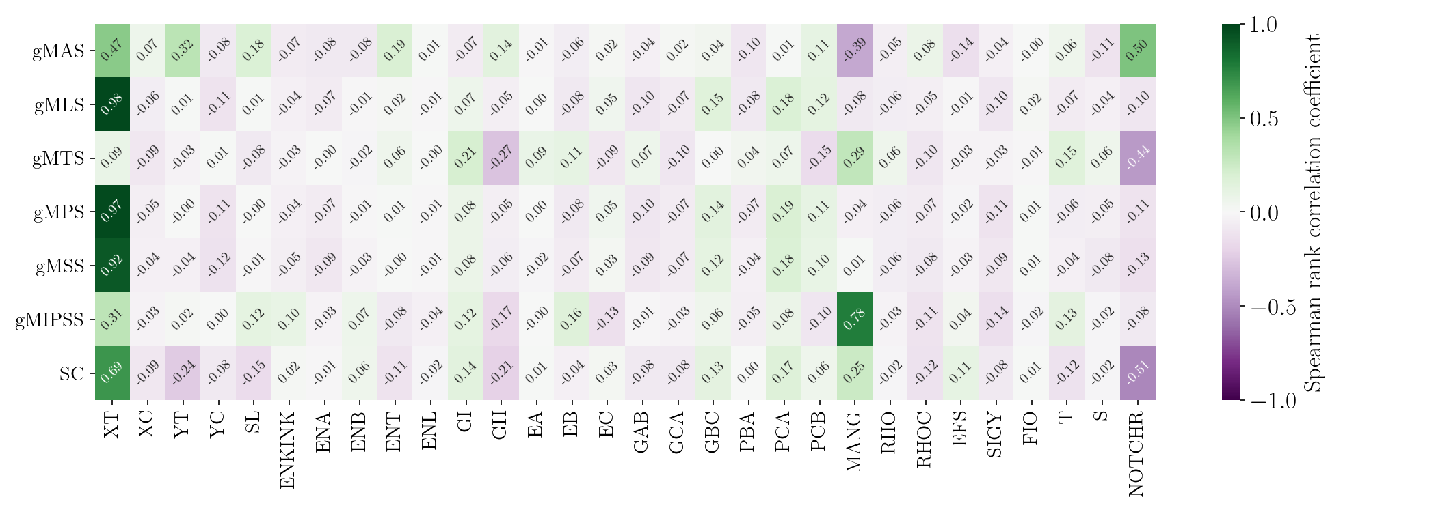
4.1 Bivariate Analysis
Pearson’s
correlation coefficient
Spearman’s ranked correlation coefficient

Slide 27
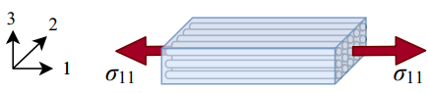
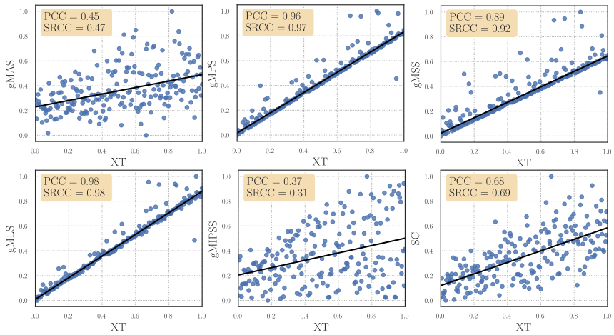
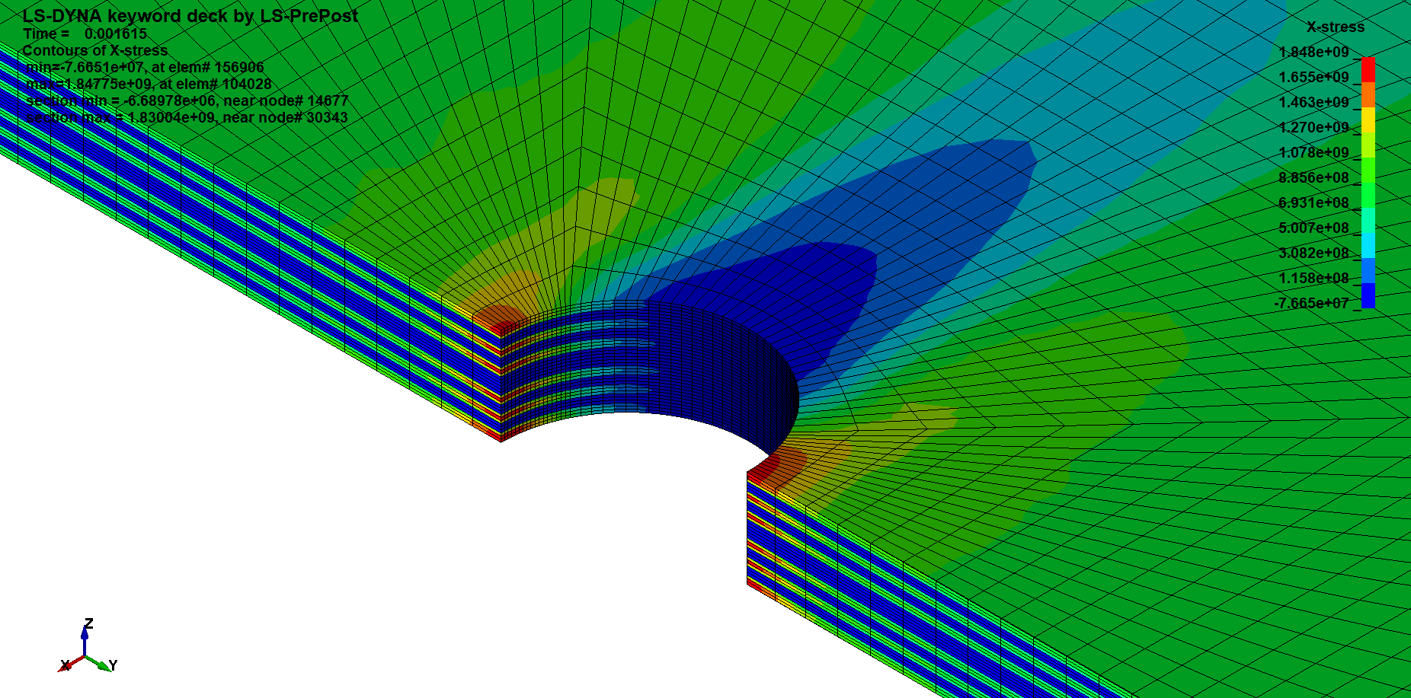
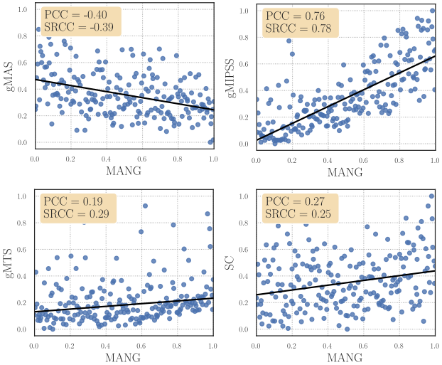
4.1 Bivariate Analysis
Influence of Longitudinal Tensile Strength (XT)
Influence of Misalignment Angle (MANG)
b
x
a
y
MANG
gMAS | Maximum applied stress in x-direction before failure
gMLS | Maximum longitudinal stress globally at maximum gMAS
gMIPSS | Maximum in-plane shear stress globally at maximum gMAS

Slide 28
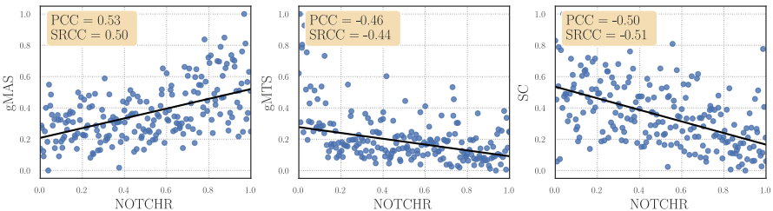
4.1 Bivariate Analysis
Influence of Notch Radius Ratio (NOTCHR)
Ry=48mm
Rx
NOTCHR =
Rx
Ry
gMAS | Maximum applied stress in x-direction before failure
SC | Stress concentration factor at the notch at maximum gMAS

Slide 29





4.2 Multiple Linear Regression Analysis
Coefficient values ($y=m1x1+m2x2$ $+ …+ mnxn+Intercept$)
Higher coefficient values for XT, YT, GI, GII, MANG and NOTCHR
Regression summary - gMAS
Higher t-value and lower P-value suggests good validity of the parameter
Notes:
What is t-value and p-value?

Slide 30
5. Conclusion

Slide 31
5.1 Conclusion
Analysis is results have shown moderate to strong dependency with:
Loading type → Tensile parameters are more dominating (XT, YT)
→ Inter laminar shear dominating (GII)
Material orientation w.r.t loading direction → MANG
Geometry of specimen → NOTCHR
Non-significant correlation values for parameters like moduli, Poisson’s ratio, fracture toughness, etc.
Not selecting appropriate response variables
Smeared effect due to complex behavior of failure in composites
Future work :
Studying experiments with different response variables
Meta modelling using neural networks (reducing time for entire simulation)
Notes:
31

Slide 32
5.1 Conclusion
Physics simulation + Exploratory data analysis
Manufacturing defects
MANG, NOTCHR
Deviation in material properties
Important parameters
Less influencing
More influencing
Limitations
Material model
Analysis software suit
Future work
Studying experiments with different response variables
Meta modelling using neural networks (reducing time for entire simulation)
Notes:
32

Slide 33
References
[1] Can Carbon Fiber Replace Steel in the Automotive Industry? by KaganPittman. url: https://www.engineering.com/story/can-carbon-fiber-replace-steel-inthe-automotive-industry,
[2] https://www.compositesworld.com/articles/more-from-jec-high-quality-carbon-fiber-monocoques-in-two-hours [3]
[3] https://www.nextbigfuture.com/2016/06/fourth-generation-composites-used-for.html
[4] https://www.engadget.com/superstrata-ion-terra-3d-printed-carbon-fiber-electric-bike-140050711.html?
[5] https://www.jmfiber.com/portfolio/carbon-fiber-tennis-racket
[6] https://www.sciencedirect.com/science/article/pii/S0263822307001341
[7] O’Higgins, R. M., McCarthy, M. A. and McCarthy, C. T. Comparison of open hole tension characteristics of high strength glass and carbon fibre-reinforced composite materials. Composites Science and Technology. Directions in Damage and Durability of Composite Materials, with regular papers 68.13, Oct. 2008, pp. 2770–2778.
[8] Davies, G A O and Olsson, R. Impact on composite structures. THE AERONAUTICAL JOURNAL, 2004, p. 23
[9] Figure 7.4 Micrographic matrix cracking in multidirectional laminate [20]. url: https: //www.researchgate.net/figure/Micrographic-matrix-cracking-in-multidirectionallaminate-20_fig4_325024206
[10] Daniel, Isaac M. and Ishai, Ori. Engineering mechanics of composite materials. 2nd ed. New York: Oxford University Press, 2006. isbn: 978-0-19-515097-1.
[11] Figure 7.4 Micrographic matrix cracking in multidirectional laminate [20]. url: https: //www.researchgate.net/figure/Micrographic-matrix-cracking-in-multidirectionallaminate-20_fig4_325024206.
[12] Suresh, Masa et al. Fractographic Analysis of Tensile Failures of Aerospace Grade Composites. Materials Research 15, Dec. 2012, pp. 990–997.

Slide 34
References
[13] Brauer, Delia et al. Degradable phosphate glass fiber reinforced polymer matrices: Mechanical properties and cell response. Journal of materials science. Materials in medicine 19, Feb. 2008, pp. 121–7.
[14] Han, Geng et al. The failure mechanism of carbon fiber-reinforced composites under longitudinal compression considering the interface. Science and Engineering of Composite Materials 24.3, May 2017, pp. 429–437.
[15] Zanjani, Jamal Seyyed Monfared et al. Nano-engineered design and manufacturing of high-performance epoxy matrix composites with carbon fiber/selectively integrated graphene as multi-scale reinforcements. RSC Advances 6.12, Jan. 2016, pp. 9495–9506.
[16] Pinho, S.T., Iannucci, L. and Robinson, P. Physically-based failure models and criteria for laminated fibre-reinforced composites with emphasis on fibre kinking: Part I: Development. Composites Part A: Applied Science and Manufacturing 37.1, Jan. 2006, pp. 63–73.
[17] Benzeggagh, M.L. and Kenane, M. Measurement of mixed-mode delamination fracture toughness of unidirectional glass/epoxy composites with mixed-mode bending apparatus. Composites Science and Technology 56.4, 1996, pp. 439–449.
[18] LS-DYNA | Livermore Software Technology Corp. url: http://www.lstc.com/products/ls-dyna
[19] https://numpy.org/
[20] https://pandas.pydata.org/
[21] https://seaborn.pydata.org/#
[22] https://www.scipy.org/
[23] https://www.statsmodels.org/stable/index.html

Slide 35
Thank you for your attention !!

Slide 36
Backup slides
Notes:
36

Slide 37



2.1 Damages in an OHT specimen
Cross-ply laminate under tensile loading:
Stresses along x-axis
[0/90/0]
Damage initiation from notch

Slide 38








2.1 Damages in a OHT specimen
Matrix Cracking
Delamination
[11]
[15]
Fibre-Matrix Debonding
Fibre Fracture
[12]
[13]
[14]
Kinking

Slide 39



Convergence analysis
Convergence analysis on 0⁰ UD ply
140 elements on the notch circumference
0 1 2 3 4
Design Points
19.23%
0
1
2
3
4
4.35%
0.19%
11.70%
12.73%
19.94%
1.52%
Stress concentration factor
Applied stress (MPa)
21.10%
Design Points
Time (sec)

Slide 40




Material model by Pinho et al.
Fibre tensile failure:
Fibre compression failure (Kinking):
Matrix tensile failure:
Matrix compressive/shear failure:
Notes:
Possible question: what is physically based criteria and how It is different from non-physically based criteria

Slide 41
Material model by Pinho et al.
Fibre compression failure (Kinking):
Notes:
Possible question: what is physically based criteria and how It is different from non-physically based criteria

Slide 42
Material model by Pinho et al.
Continuum damage model
Notes:
Possible question: what is physically based criteria and how It is different from non-physically based criteria

Slide 43




Linear Regression and Sensitivity analysis
Regression
Fitting line –
Error –
Objective –
R-Squared –
PCC –
R-Squared = PCC²

Slide 44

Full heatmap Bivariate analysis
Pearson’s correlation coefficient (PCC) heatmap

Slide 45

Bivariate analysis – Full heatmap
Spearman’s ranked correlation coefficient (SRCC) heatmap

Slide 46

Heatmap when all parameters are varied equally

Slide 47



2.1 Analysis of composite
Multi-Scale analysis
Composite material as an orthotropic material.
Tensile loading direction and Fibre direction in a lamina
Loading parallel to fibre direction
Fibres take major loads
Loading non-parallel to fibre direction
As increases, load shifts towards matrix
[10]
Mesoscopic Level
2
x
1
y
Notes:
Orthotropic material
→Subset of anisotropic material (at meso scale).
→3 material axes of symmetry
→Material Properties are direction dependent

